Slide 1
Software Testing
Continued...
Rajib Mall
CSE Department
IIT KHARAGPUR

Slide 2
White-Box Testing

Slide 3
What is White-box Testing?
White-box test cases designed based on:
  Code structure of program.
  White-box testing is also called structural testing.

Slide 4
White-Box Testing Strategies
Coverage-based:
  Design test cases to cover certain program elements.
Fault-based:
  Design test cases to expose some category of faults

Slide 5
White-Box Testing
Several white-box testing strategies have become very popular :
  Statement coverage
  Branch coverage
  Path coverage
  Condition coverage
  MC/DC coverage
  Mutation testing
  Data flow-based testing

Slide 6
Why Both BB and WB Testing?
Black-box .
Impossible to write a test case for every possible set of inputs and outputs
Some code parts may not be reachable
Does not tell if extra functionality has been implemented.
White-box .
Does not address the question of whether a program matches the specification
Does not tell if all functionalities have been implemented
Does not uncover any missing program logic

Slide 7
Coverage-Based Testing Versus Fault-Based Testing
Idea behind coverage-based testing:
  Design test cases so that certain program elements are executed (or covered).
  Example: statement coverage, path coverage, etc.
Idea behind fault-based testing:
  Design test cases that focus on discovering certain types of faults.
  Example: Mutation testing.

Slide 8
Types of program element Coverage
Statement: each statement executed at least once
Branch: each branch traversed (and every entry point taken) at least once
Condition: each condition True at least once and False at least once
Multiple Condition: All combination of Condition covered
Path:
Dependency:

Slide 9
Stronger and Weaker Testing
Stronger
Coverage
Weaker

Slide 10
Complementary Testing
Coverage
Strategy 1
Strategy 2

Slide 11
Stronger, Weaker, and Complementary Testing
Complementary
Weaker

Slide 12
Statement Coverage
Statement coverage strategy:
  Design test cases so that every statement in the program is executed at least once.

Slide 13
Statement Coverage
The principal idea:
  Unless a statement is executed,
  We have no way of knowing if an error exists in that statement.

Slide 14
Statement Coverage Criterion
However, observing that a statement behaves properly for one input value:
  No guarantee that it will behave correctly for all input values!

Slide 15
Statement Coverage
Coverage measurement:
# executed statements
# statements
Rationale: a fault in a statement can only be revealed by executing the faulty statement
Notes:
12.2 STATEMENT TESTING

Slide 16
Example
int f1(int x, int y){
1 while (x != y){
2 if (x>y) then
3 x=x-y;
4 else y=y-x;
5 }
6 return x; }
Euclid's GCD Algorithm

Slide 17
Example
int f1(int x,int y){
1 while (x != y){
2 if (x>y) then
3 x=x-y;
4 else y=y-x;
5 }
6 return x; }
Euclid's GCD Algorithm

Slide 18
Euclid's GCD Algorithm
By choosing the test set {(x=3,y=3),(x=4,y=3), (x=3,y=4)}
  All statements are executed at least once.

Slide 19
Branch Coverage
Also called decision coverage.
Test cases are designed such that:
  Each branch condition
    Assumes true as well as false value.

Slide 20
Example
int f1(int x,int y){
1 while (x != y){
2 if (x>y) then
3 x=x-y;
4 else y=y-x;
5 }
6 return x; }

Slide 21
Example
Test cases for branch coverage can be:
{(x=3,y=3),(x=3,y=2), (x=4,y=3), (x=3,y=4)}

Slide 22
Branch Testing
Adequacy criterion: Each branch (edge in the CFG) must be executed at least once.
Coverage:
# executed branches
# branches

Slide 23
Quiz 1: Branch and Statement Coverage: Which is Stronger?
Branch testing guarantees statement coverage:
  A stronger testing compared to the statement coverage-based testing.

Slide 24
Stronger Testing
Stronger testing:
  Superset of weaker testing
  A stronger testing covers all the elements covered by a weaker testing.
  Covers some additional elements not covered by weaker testing

Slide 25
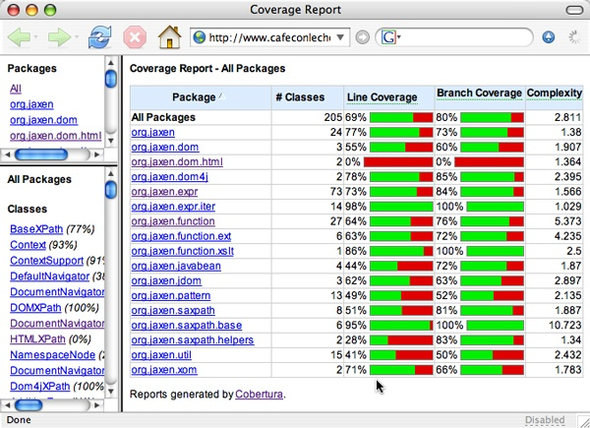
Coverage Report

Slide 26
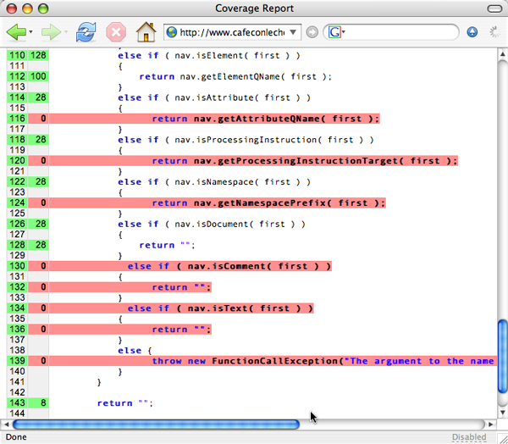

Slide 27
Statements vs Branch Testing
Traversing all edges of a graph causes all nodes to be visited
  So a test suite that satisfies branch adequacy criterion also satisfies statement adequacy criterion for the same program.
The converse is not true:
  A statement-adequate (or node-adequate) test suite may not be branch-adequate (edge-adequate).
Notes:
The example of two slides ago illustrates this point

